Slide 1
Hour 2, Lecture 3
Understanding the Gameplay Framework

Slide 2
Introduction
This lecture introduces you to the Gameplay Framework, which is a collection of C++ or Blueprint classes that manages the rules of your game, handles player input, and defines the avatars, cameras, and player HUDs in UE4 projects.
Don’t let the terminology fool you. While UE4 has been developed to make games and much of the terminology is game related, UE4 can be used to make many different applications.

Slide 3
Lecture Goals and Outcomes
Goals
Outcomes
The goals of this lecture are to
Become familiar with the Gameplay Framework
Learn about the relationship between the Game Mode and a Game Instance
Learn about the Pawn, HUD, Player Controller, Player State, and Game State classes
By the end of this lecture you will be able to
Discuss the Gameplay Framework
Understand the relationship between the Game Mode and a Game Instance
Understand the relationship between the Pawn, HUD, Player Controller, Player State, and Game State classes

Slide 4
Gameplay Framework
GameMode
class
Pawn
class
HUD
class
Player Controller
class
Player State
class
Game State
class
GameInstance
class

Slide 5
Game Mode
class
Pawn
class
HUD
class
Player Controller
class
Player State
class
Game State
class
Game Instance
class
Game Mode class
The Game Mode class is used to set the rules of the game and store all the other classes that are needed to define the game’s core functionality.
Note: The Game Mode class is a good place to script respawn systems for a first-person shooter or a timer for a race game.

Slide 6
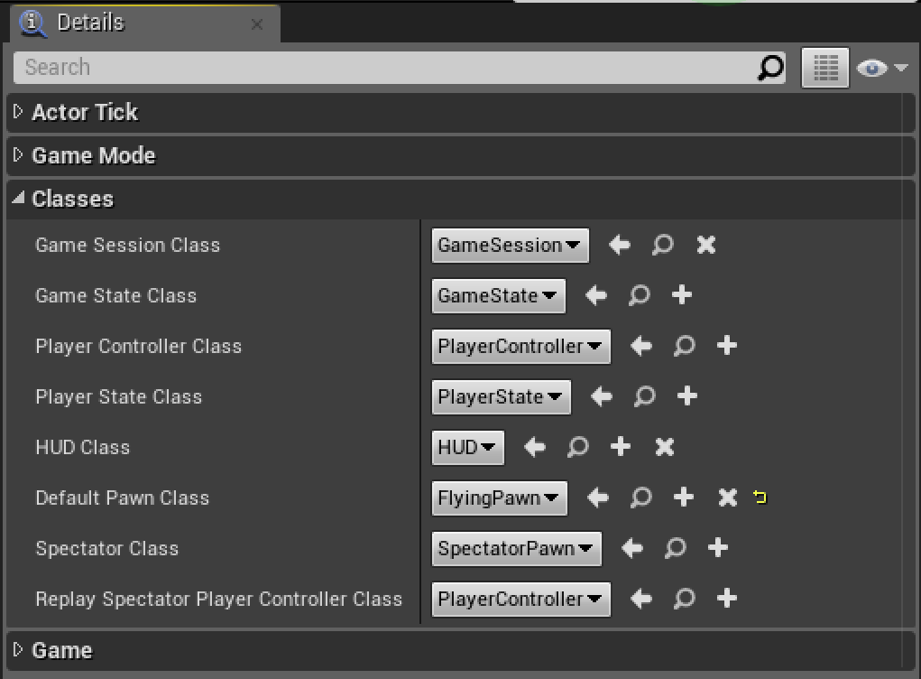
Game Mode class
You can assign the Game Mode to a project or to each individual Level in a project.
Often, projects have two or three Game Modes, but of course only one can be assigned as the default mode.
Game Modes cannot be changed once a Level is loaded.

Slide 7
Game Mode
class
Pawn
class
HUD
class
Player Controller
class
Player State
class
Game State
class
Game Instance
class
Pawn Class
The Pawn class is the base class of all Actors that can be controlled by players or AI.
A Pawn is the physical representation of a player or AI entity within the world.
The Pawn determines not only what the player or AI entity looks like visually, but also how it interacts with the world in terms of collisions and other physical interactions.

Slide 8
Game Mode
class
Pawn
class
HUD
class
Player Controller
class
Player State
class
Game State
class
Game Instance
class
Pawn Class
The Pawn represents the physical location, rotation, and so on of a player or entity within the game. A Character is a special type of Pawn that has prebuilt movement and input systems.

Slide 9
Game Mode
class
Pawn
class
HUD
class
Player Controller
class
Player State
class
Game State
class
Game Instance
class
Pawn Class
There are several classes that can be assigned to the DefaultPawn class property in a Game Mode:
Pawn class
Character class
Vehicle class
A Pawn class is a generic class for creating a variety of Pawn types, while Character and Vehicle classes are set up for dealing with specific but common Pawns found in most games.
Notes:
Since Pawns take direction from a controller class, Pawns can be controlled by the PlayerController class or the AIController class.

Slide 10
Game Mode
class
Pawn
class
HUD
class
Player Controller
class
Player State
class
Game State
class
Game Instance
class
HUD Class
The HUD (heads-up display) is the base object for displaying 2D elements overlaid on the screen.
Every human-controlled player in the game has their own instance of the HUD class that draws to their individual Viewport.
In the case of split-screen multiplayer games, multiple Viewports share the same screen but each HUD still draws to its own Viewport.
The type, or class, of HUD to use is specified by the Game Mode being used.
Notes:
The HUD class is used to draw 2D interface content to the player’s screen and create an in-game heads-up display (HUD). A game’s entire HUD system can be scripted in the HUD class. Epic has also provided an interface editor called Unreal Motion Graphics (UMG), which is a collection of tools and classes for building complex interfaces and HUDs. (See Lecture 22, “Introduction to UMG.”)

Slide 11
Game Mode
class
Pawn
class
HUD
class
Player Controller
class
Player State
class
Game State
class
Game Instance
class
Player Controller Class
A Player Controller is the interface between the Pawn and the human player controlling it.
The Player Controller decides what to do and then issues commands to the Pawn (for example, “start crouching,” “jump”).
The Player Controller persists throughout the game, while the Pawn can be transient.
Notes:
For example, in deathmatch style gameplay, you may die and respawn, so you would get a new Pawn but your PlayerController would be the same. In this example, if you kept your score on your Pawn, the score would reset, but if you kept your score on your PlayerController, it would not.

Slide 12
Game Mode
class
Pawn
class
HUD
class
Player Controller
class
Player State
class
Game State
class
Game Instance
class
Player Controller Class
There are two basic types of controller classes: Player Controller and AI Controller.
Every human player in a game has an instance of the Player Controller class assigned to them.
Notes:
PlayerController classes do not have physical representations in the game world.

Slide 13
Game Mode
class
HUD
class
Player Controller
class
Player State
class
Game State
class
Game Instance
class
Pawn
class
Player Controller Class
Player inputs can be anything from mice and keyboards or gamepads to touch screens or an Xbox Kinect.
Notes:
The PlayerController class is also where you can turn on visibility of the mouse cursor and set how the game will respond to mouse-click events.

Slide 14
Game Mode
class
Pawn
class
HUD
class
Player Controller
class
Player State
class
Game State
class
Game Instance
class
Player State Class
A Player State is the state of a participant in the game, such as a human player or a bot that is simulating a player.
Non-player AI that exists as part of the game would not have a Player State.
Example data that would be appropriate in a Player State include player name, score, or whether the player is currently carrying the flag in a CTF game.
Player States for all players exist on all machines (unlike Player Controllers) and can replicate freely to keep things in sync.

Slide 15
Game Mode
class
Pawn
class
HUD
class
Player Controller
class
Player State
class
Game State
class
Game Instance
class
Game State Class
The Game State contains the state of the game, which could include things like the list of connected players, the score, where the pieces are in a chess game, or the list of what missions you have completed in an open world game.
The Game State exists on the server and all clients and can replicate freely to keep all machines up to date.

Slide 16
Game Mode
class
Pawn
class
HUD
class
Player Controller
class
Player State
class
Game State
class
Game Instance
class
Game Instance Class
The Game Instance is a class whose state withstands the switching of Levels.
Classes like Game Mode or Player Controller are destroyed between Level loads/resets, and data stored in those classes is removed.
Any data that you want to keep between Levels (for example, the player’s health and ammo or overall score) should be placed in the Game Instance.

Slide 17
Exercise
Create a new blank project with starter content or use an existing project.
In the Content Browser, use the Add New button to add three Game Mode templates of your choice to the project.
Assign one Game Mode as the default Game Mode under Project Settings. Then create two new Levels for the project and use World Settings properties to assign the other Game Mode templates to each of the Levels.
Playtest each Level and verify that each Level uses a different Game Mode.
Notes:
Sample external model and Texture files can be downloaded here: http://www.sty-ue4.com/STIY_24_UE4/Hour_02.zip.

